Slide 1
Bag of Words Models
MMCi Block 4
Matthew Engelhard
Notes:
Name
Department & DS Program
I work in…
I’m here to…
This will be the first of three lectures this spring focused on ways data science is positioned to change (and beginning to change) clinical practice. We’re doing this because we think these technologies are going to have a major impact on the way you practice medicine, and we want you to be ready for them.

Slide 2
Lecture 1: what is a predictive model?
y, associated value or label
x, data/features for a subject or patient
End goal: predict y from x
-> Brief review
Notes:
Let’s take a moment to review what we discussed last time
Opportunity to answer questions, which we didn’t have before
We talked about the basics of a predictive model.
It takes a set of data, or features, x, and applies a mathematical function or logic to make a prediction about an associated value, y
The thing that takes x and returns the prediction about y – that’s the model, the ”machine” in machine learning.

Slide 3
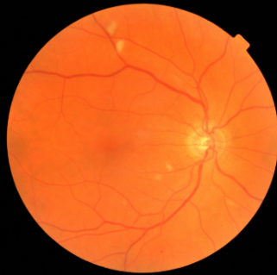
Lecture 2: a predictive model for image data
y, referrable diabetic retinopathy
x, retinal image
End goal: predict y from x
-> Brief review
Notes:
So now that we’ve talked about the simplest case
-- what’s a predictive model
-- how do we measure and understand performance – which is what we need to understand well in order to USE them
We’re going to go to the opposite end of the spectrum and talk about an incredibly complex model
-- we’ll talk about how it works
-- but the big thing I want to emphasize is that if we understand what these models are, big picture, and we understand how their performance is and should be measured – that’s what you need to know to be able to use them effectively, as clinicians, in my view.
-- these are just another very fancy diagnostic tool in your toolbox. There are a few caveats, which we’ll discuss at the end
But before we move on – let’s pause for questions.

Slide 4
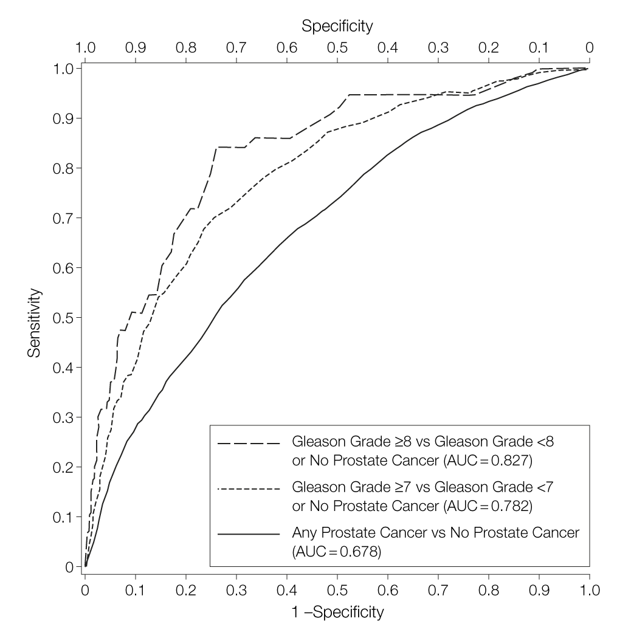
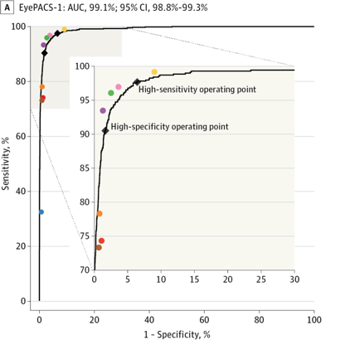
Evaluate performance just like any other diagnostic tool
-> Brief review
Notes:
What’s important is understanding these performance characteristics – deeply, intuitively.
Understand what a given sensitivity means in your diagnostic setting
How many false positives (in light of the baseline rate)? How many false negatives (in light of the baseline rate)? How useful will this be to you?
Now, when we move beyond binary classification – admittedly things get more complicated –
But the point remains – what’s important here is that you be able to evaluate performance
And that you look critically at performance characteristics.
Have they shown that this works beyond the individuals it was originally trained on?
And by the way, these rules are not different for the machine learning people
They might know more about how the models are trained, but they can make the same kinds of errors

Slide 5
Today: a predictive model for text data
What can “natural language processing” (NLP) do?
Existing non-medical applications
Possible medical applications
How can we convert text into something a predictive model can understand?
Evaluating and understanding NLP models
Notes:
So today we continue in that vein
We want to see how natural language processing – really it’s just predictive modeling
We have some text and we want to make a prediction based on that text. We’re going to train a machine, using many examples of (a) text, and (b) the corresponding prediction, how to make ‘good’ predictions
Then we evaluate, on new data it hasn’t seen before, how good those predictions are
Let’s start with some examples of what NLP can do, and then we’ll move into the details of how we can use text in a predictive model.

Slide 6


Sentiment Analysis: An “easy” binary classification problem
Machine Learning Model
“That movie was terrible!”
“This is the best jacket that I’ve ever owned”
“Not really that good.”
Notes:
The canonical NLP example is sentiment analysis
Describe
This is a binary classification problem – the metrics for evaluating performance are the same as the ones we’ve discussed
Sensitivity/specificity, PPV, NPV, AUC, etc
This is the setup we will focus on today, and the most common setup.

Slide 7
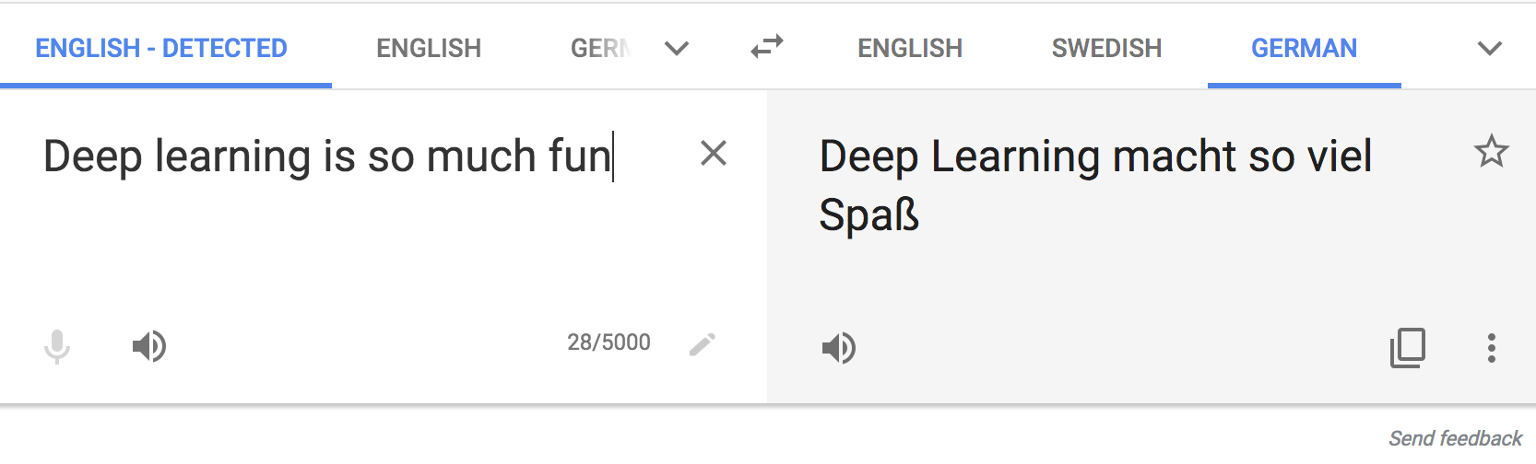
Text Translation
translate.google.com
Notes:
Input is a sequence
Output is a sequence

Slide 8
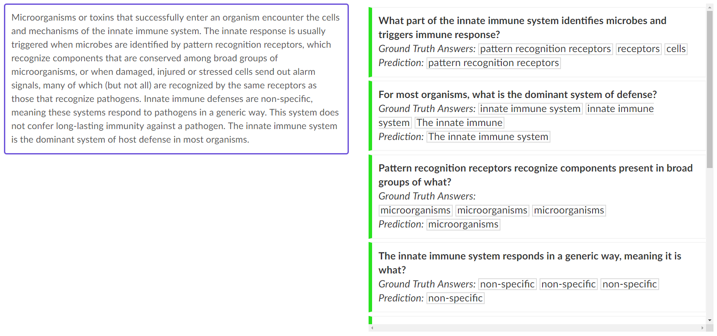
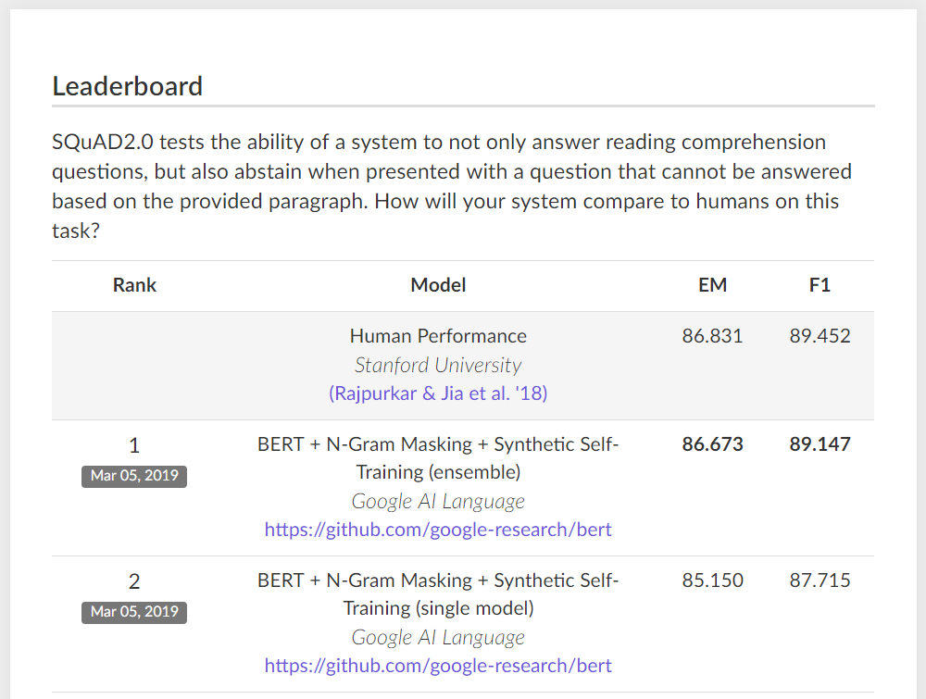
Question Answering
Notes:
Describe question answering
The correct output is actually a portion of the input text –
Here we have paragraph about the immune system along with relevant questions that can be answered. But again, not all of these questions can be answered, and it is important for the system to recognize this.
Important – we want a model that knows when it doesn’t know! This was the difference between older vs newer question answering setups
different setup, requires a different model! But still, the key is – how do we apply predictive modeling to text in the first place -- how do we get from text to numbers. Not at all obvious.
Now: can we use this approach to query the health record??
When you think about what NLP can accomplish, here’s a good way to do it.
Think about tasks that a doctor can do easily, but that take them a lot of time.
Think about all the time you spend combing through the chart…
Can we reduce that?

Slide 9
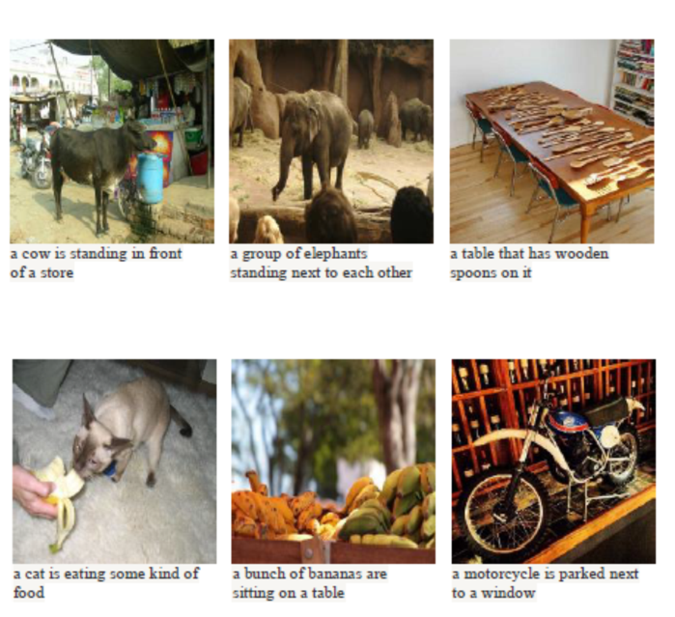
Automatic Image Captioning
Notes:
This is a little different from what we’re talking about today – more akin to image processing, as the input is an image
And we are not going to talk about text generation.
But imagine possibilities here: Think: radiology report

Slide 10
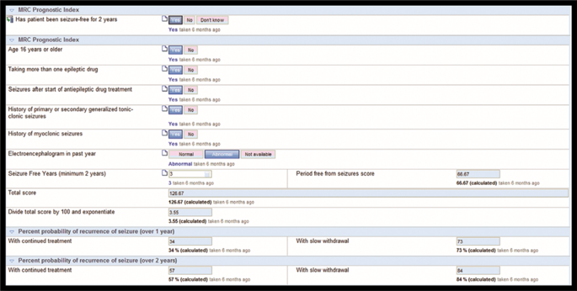
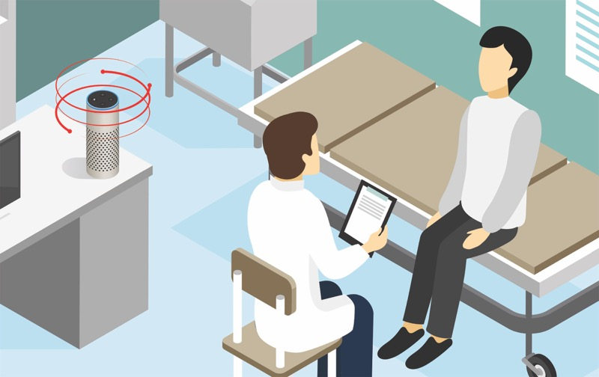
Populating Standardized Forms
Narayanan et al, Epilepsia (2017)
Notes:
Could imaging the system alerting you to data that is missing…

Slide 11
Text Generation
SYSTEM PROMPT (HUMAN-WRITTEN)
A train carriage containing controlled nuclear materials was stolen in Cincinnati today. Its whereabouts are unknown.
MODEL COMPLETION (MACHINE-WRITTEN, FIRST TRY)
The incident occurred on the downtown train line, which runs from Covington and Ashland stations.
In an email to Ohio news outlets, the U.S. Department of Energy said it is working with the Federal Railroad Administration to find the thief.
“The theft of this nuclear material will have significant negative consequences on public and environmental health, our workforce and the economy of our nation,” said Tom Hicks, the U.S. Energy Secretary, in a statement. “Our top priority is to secure the theft and ensure it doesn’t happen again.”
The stolen material was taken from the University of Cincinnati’s Research Triangle Park nuclear research site, according to a news release from Department officials.
The Nuclear Regulatory Commission did not immediately release any information.
According to the release, the U.S. Department of Energy’s Office of Nuclear Material Safety and Security is leading that team’s investigation.
“The safety of people, the environment and the nation’s nuclear stockpile is our highest priority,” Hicks said. “We will get to the bottom of this and make no excuses.
“Better Language Models and Their Implications”
2/14/19
OpenAI
Notes:
Generative models based on transformer architecture and trained on 8 million webpages

Slide 12

Suggested Email Responses
Notes:
Flooded with email
Not reimbursed
In the evening
Imagine a system that presents generated text that you can edit, or suggests multiple possible responses
Or “triages” messages to identify the important ones or categorize them
Seeing this happen with suggested responses in Gmail

Slide 13
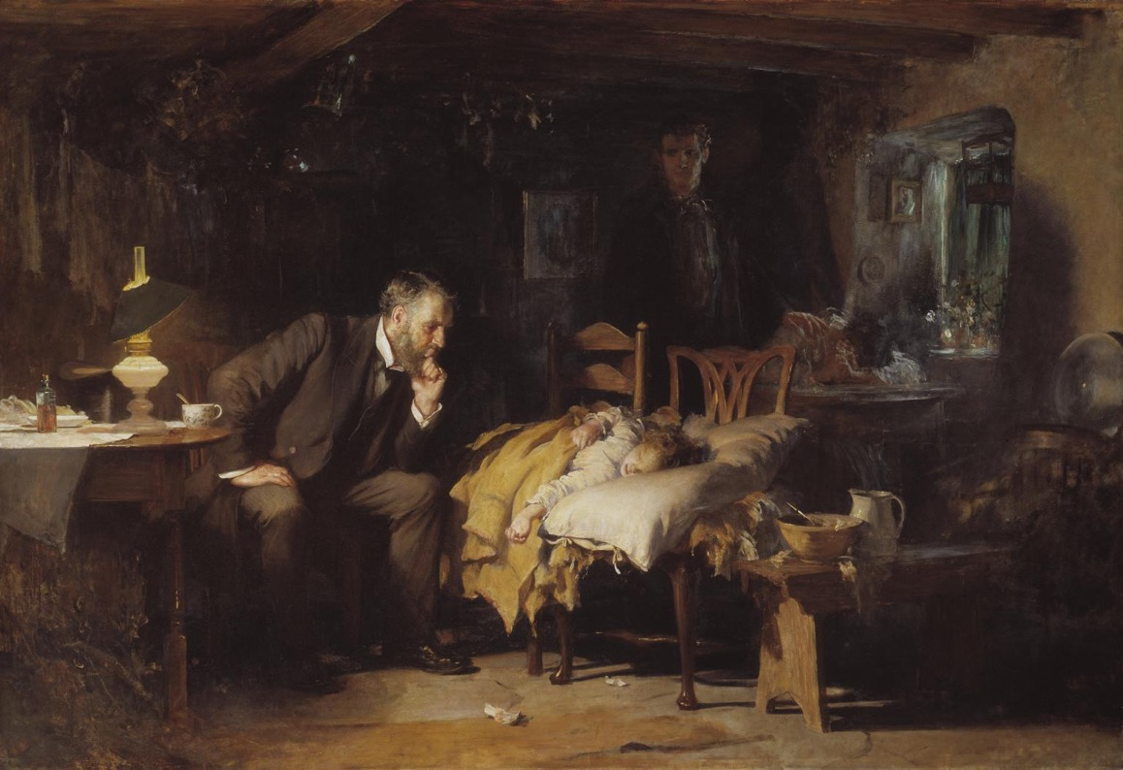
The Doctor
(Luke Fildes, 1891)
Inspired by MLHC keynote by
Abraham Verghese, MD, MACP, Stanford University
Notes:
vur geez with a hard ‘g’, Chair of internal medicine at Stanford
Came to speak at the machine learning for healthcare conference last year about the role of machine learning in clinical practice
Fildes lost his first child, his one-year-old son, Philip, from typhoid fever on Christmas morning, 1877, and recalled the doctor attending to him compassionately
Spoke more eloquently – but the idea is that there was once an intimate relationship between doctor and patient
That relationship has been interrupted – reasons are complicated, but technology is one of them
If Sir Luke Fildes had drawn in 2018, it would look like…

Slide 14
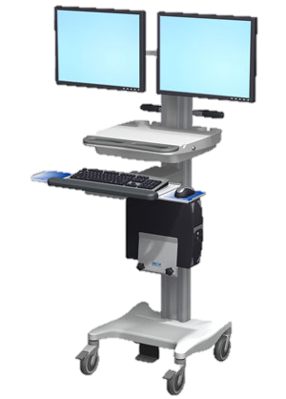
The Doctor,
circa 2018
Inspired by MLHC keynote by
Abraham Verghese, MD, MACP, Stanford University
Notes:
An exaggeration, but one based in truth
Why EHR?
– documentation trail
-- structured, standardized data
Less time for patient provider interaction
Conflict narrative structure and standardization

Slide 15

Reducing Burden and Restoring Patient-Provider Interaction
The Burnout Crisis in American Medicine
Rena Xu
The Atlantic
May 11, 2018
Notes:
We want to push toward a future where technology is used to RESTORE the intimacy of patient provider encounters – give more time, reduce unnecessary work – unfortunately, it seems that so often, innovations end up creating more work instead. Still have to monitor the patients, and now we also have to monitor the models. Let’s hope we can push this in the right direction.

Slide 16

Case Study: SMS Triage for Global Maternal Health
Maternal Health HelpDesk:
2 million women connected to NDoH staff via SMS
https://www.praekelt.org
Binary Classification: Urgent Message? (Yes/No)
Notes:
With all that said, let’s talk a little bit about the details of how we can make predictions using text.
I’m going to move quickly here, so please speak up if/when anything is unclear.

Slide 17
Case Study: SMS Triage for Global Maternal Health
https://www.praekelt.org
Can we use a standard predictive model
setup to solve this problem?
Notes:
F1-score is harmonic mean of the two

Slide 18
A Simple Predictive Model: ICU Mortality
???
WBC Count
Respiratory Rate
Creatinine
Mean BP
Hematocrit
Age
Temperature
Pulse Rate
Survival
End goal: predict odds of hospital mortality
Notes:
ACUTE PHYSIOLOGY AND CHRONIC HEALTH EVALUATION
Predictive models are nothing new in medicine – APACHE, for instance – this is to predict mortality in ICU setting – has been around since the 70s.
In an ICU setting, we might want a model that takes a bunch of measurements about a patient -- their age (demographics), vitals, lab values, and some information about chronic health conditions and predicts their risk of dying (or likelihood of surviving…)

Slide 19
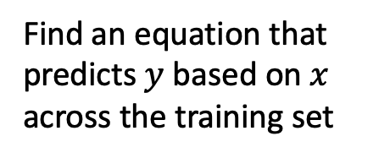
Training Set (Historical Data)
x₁
y₁
Find an equation that predicts $y$ based on $x$ across the training set
x₂
y₂
x₃
y₃
x₄
y₄
…
…
x_{N-1}
y_{N-1}
x_{N}
y_{N}
Notes:
How do we do that?
Gather a bunch of historical data
Want to find an equation that predicts y well based on x across that historical data
Y could be a numeric value, or a rank – but today, we’re going to assume that y is binary.
We model (y) as a Bernoulli random variable – this just means that it’s an event that may or may not occur, with some probability – and we suppose that probability is a function of x
So we take all this data, we use it to find the parameters that are most consistent with the patterns of x and y that are present

Slide 20
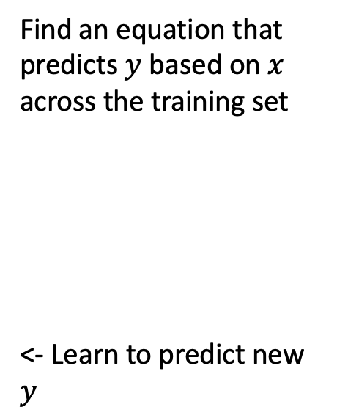

Making Predictions for New $x$
x₁
y₁
x₂
y₂
Find an equation that predicts $y$ based on $x$ across the training set
<- Learn to predict new $y$
x₃
y₃
x₄
y₄
…
…
x_{N-1}
y_{N-1}
x_{N}
y_{N}
x_{N+1}
y_{N+1}
Notes:
Having done that, we have a trained model. Our parameters are learned – we hold them fixed.
Now, when we see a NEW value of x, we simply plug it into our “learned” equation, and it tells us what we expect y to be. This is prediction.

Slide 21
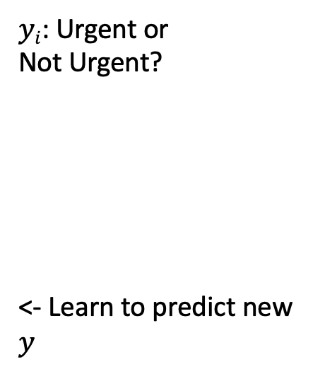
This time, our training data is text
x₁
What helps with morning sickness?
How many months should I breastfeed?
I passed out and Mom said I was shaking
Where is the nearest clinic?
I am having heavy bleeding, what should I do?
What foods should I eat while pregnant?
My heart is racing and I can’t catch my breath
y₁
x₂
y₂
x₃
y₃
$yi$: Urgent or
Not Urgent?
<- Learn to predict new $y$
x₄
y₄
…
…
x_{N-1}
y_{N-1}
x_{N}
y_{N}
x_{N+1}
y_{N+1}
Notes:
Having done that, we have a trained model. Our parameters are learned – we hold them fixed.
Now, when we see a NEW value of x, we simply plug it into our “learned” equation, and it tells us what we expect y to be. This is prediction.

Slide 22
We need numbers, not words
Can we convert our text to a vector or sequence of numbers?
If yes, we can use logistic regression (or any other predictive model)!

Slide 23
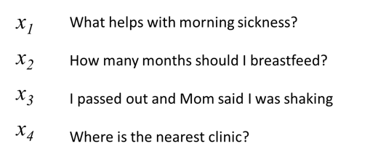
First try: count words in each SMS Step 1: Define a vocabulary of words
shaking
what
clinic
how
helps
was
nearest
many
with
said
months
the
morning
mom
should
sickness
and
I
is
how
out
breastfeed
passed
where
list of all words
(in no particular order)

Slide 24
Step 2: count how many times each vocabulary word appears in a given SMS
shaking
what
clinic
how
helps
was
nearest
many
with
said
months
the
morning
mom
should
sickness
and
I
is
how
out
breastfeed
passed
where
What helps with morning sickness?
x₁
0 | 1 | 0 | 0 | 1 | 0 | 0 | 0 | 1 | 0 | 0 | 0 | 1 | 0 | 0 | 1 | 0 | 0 | 0 | 0 | 0 | 0 | 0 | 0
Notes:
ACUTE PHYSIOLOGY AND CHRONIC HEALTH EVALUATION
Predictive models are nothing new in medicine – APACHE, for instance – this is to predict mortality in ICU setting – has been around since the 70s.
In an ICU setting, we might want a model that takes a bunch of measurements about a patient -- their age (demographics), vitals, lab values, and some information about chronic health conditions and predicts their risk of dying (or likelihood of surviving…)

Slide 25
Step 2: count how many times each vocabulary word appears in a given SMS
shaking
what
clinic
how
helps
was
nearest
many
with
said
months
the
morning
mom
should
sickness
and
I
is
how
out
breastfeed
passed
where
I passed out and Mom said I was shaking
x₃
1 | 0 | 0 | 0 | 0 | 1 | 0 | 0 | 0 | 1 | 0 | 0 | 0 | 1 | 0 | 0 | 0 | 2 | 0 | 0 | 1 | 0 | 1 | 0
Notes:
ACUTE PHYSIOLOGY AND CHRONIC HEALTH EVALUATION
Predictive models are nothing new in medicine – APACHE, for instance – this is to predict mortality in ICU setting – has been around since the 70s.
In an ICU setting, we might want a model that takes a bunch of measurements about a patient -- their age (demographics), vitals, lab values, and some information about chronic health conditions and predicts their risk of dying (or likelihood of surviving…)

Slide 26
Step 2: count how many times each vocabulary word appears in a given SMS
shaking
what
clinic
how
helps
was
nearest
many
with
said
months
the
morning
mom
should
sickness
and
I
is
how
out
breastfeed
passed
where
Where is the nearest clinic?
x₄
0 | 0 | 1 | 0 | 0 | 0 | 1 | 0 | 0 | 0 | 0 | 1 | 0 | 0 | 0 | 0 | 0 | 0 | 1 | 0 | 0 | 0 | 0 | 1
Notes:
ACUTE PHYSIOLOGY AND CHRONIC HEALTH EVALUATION
Predictive models are nothing new in medicine – APACHE, for instance – this is to predict mortality in ICU setting – has been around since the 70s.
In an ICU setting, we might want a model that takes a bunch of measurements about a patient -- their age (demographics), vitals, lab values, and some information about chronic health conditions and predicts their risk of dying (or likelihood of surviving…)

Slide 27
Note that word order does not matter!
shaking
what
clinic
how
helps
was
nearest
many
with
said
months
the
morning
mom
should
sickness
and
I
is
how
out
breastfeed
passed
where
clinic is where nearest the
x_{4'}
0 | 0 | 1 | 0 | 0 | 0 | 1 | 0 | 0 | 0 | 0 | 1 | 0 | 0 | 0 | 0 | 0 | 0 | 1 | 0 | 0 | 0 | 0 | 1
Notes:
ACUTE PHYSIOLOGY AND CHRONIC HEALTH EVALUATION
Predictive models are nothing new in medicine – APACHE, for instance – this is to predict mortality in ICU setting – has been around since the 70s.
In an ICU setting, we might want a model that takes a bunch of measurements about a patient -- their age (demographics), vitals, lab values, and some information about chronic health conditions and predicts their risk of dying (or likelihood of surviving…)

Slide 28

A “bag of words”
clinic
nearest
where
the
is

Slide 29
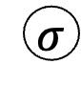
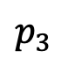
Logistic Regression for Text Classification
shaking
what
clinic
how
helps
was
nearest
many
with
said
months
the
morning
mom
should
sickness
and
I
is
how
out
breastfeed
passed
where
$$p_{3}$$
$$σ$$
z₃
b₁
b_{M}
x₃
1 | 0 | 0 | 0 | 0 | 1 | 0 | 0 | 0 | 1 | 0 | 0 | 0 | 1 | 0 | 0 | 0 | 2 | 0 | 0 | 1 | 0 | 1 | 0
I passed out and Mom said I was shaking

Slide 30
Logistic Regression for Text Classification
shaking
what
clinic
how
helps
was
nearest
many
with
said
months
the
morning
mom
should
sickness
and
I
is
how
out
breastfeed
passed
where
$$p_{3}$$
$$σ$$
z₃
b₁
b_{M}
x₃
1 | 0 | 0 | 0 | 0 | 1 | 0 | 0 | 0 | 1 | 0 | 0 | 0 | 1 | 0 | 0 | 0 | 2 | 0 | 0 | 1 | 0 | 1 | 0
I passed out and Mom said I was shaking

Slide 31
Logistic Regression for Text Classification
shaking
what
clinic
how
helps
was
nearest
many
with
said
months
the
morning
mom
should
sickness
and
I
is
how
out
breastfeed
passed
where
$$p_{3}$$
near 1 (urgent)
$$σ$$
large
z₃
b₁
b_{M}
x₃
1 | 0 | 0 | 0 | 0 | 1 | 0 | 0 | 0 | 1 | 0 | 0 | 0 | 1 | 0 | 0 | 0 | 2 | 0 | 0 | 1 | 0 | 1 | 0
I passed out and Mom said I was shaking

Slide 32
Strengths and Weaknesses
(+) This approach is simple and works surprisingly well in practice
(+) Often the best approach with small datasets
(-) Does not capture word order
(-) Does not group synonyms together or understand semantic relationships between words

Slide 33
2nd try: count 1- and 2-grams in each SMS (i.e. extend vocabulary to include 2-word phrases)
shaking
what
clinic
how
helps
was
nearest
many
with
said
months
the
morning
mom
should
sickness
and
I
is
how
out
breastfeed
passed
where
1-grams
what helps
helps with
with morning
morning sickness
how many
many months
months should
should I
I breastfeed
I passed
passed out
out and
and mom
mom said
said I
I was
was shaking
where is
is the
the nearest
nearest clinic
2-grams

Slide 34
n-grams can be very helpful!
I am not sick and feel great
Bag of 1-grams: no difference between these sentences
I am not great and feel sick

Slide 35
n-grams can be very helpful!
I am not sick and feel great
Bag of 1- and 2-grams:
not sick, feel great
versus
not great, feel sick
I am not great and feel sick

Slide 36
3rd try: more powerful methods to work with…
(a) word meaning: assign words to vectors that encode their meaning numerically
(b) words in context: neural network architectures that act on sequences of words (rather than a bag of words)

Slide 37
More Text Processing Details
(for bag of words models)

Slide 38
Variations on counting: term frequency
term count: ‘times’
“It was the best of times, it was the worst of times, it was the age of wisdom, it was the age of foolishness, it was the epoch of belief, it was the epoch of incredulity, it was the season of Light, it was the season of Darkness, it was the spring of hope, it was the winter of despair, we had everything before us, we had nothing before us, we were all going direct to Heaven, we were all going direct the other way—in short, the period was so far like the present period, that some of its noisiest authorities insisted on its being received, for good or for evil, in the superlative degree of comparison only.”
2
“And the first one now Will later be last For the times they are a-changin'.”
1

Slide 39
Variations on counting: term frequency
term frequency: ‘times’
“It was the best of times, it was the worst of times, it was the age of wisdom, it was the age of foolishness, it was the epoch of belief, it was the epoch of incredulity, it was the season of Light, it was the season of Darkness, it was the spring of hope, it was the winter of despair, we had everything before us, we had nothing before us, we were all going direct to Heaven, we were all going direct the other way—in short, the period was so far like the present period, that some of its noisiest authorities insisted on its being received, for good or for evil, in the superlative degree of comparison only.”
2/119
“And the first one now Will later be last For the times they are a-changin'.”
1/16
-> better measure of the importance of
the term within a given text sample

Slide 40
Variations on counting: inverse document frequency
2/2
document frequency: ‘times’
“It was the best of times, it was the worst of times, it was the age of wisdom, it was the age of foolishness, it was the epoch of belief, it was the epoch of incredulity, it was the season of Light, it was the season of Darkness, it was the spring of hope, it was the winter of despair, we had everything before us, we had nothing before us, we were all going direct to Heaven, we were all going direct the other way—in short, the period was so far like the present period, that some of its noisiest authorities insisted on its being received, for good or for evil, in the superlative degree of comparison only.”
✔
✔
“And the first one now Will later be last For the times they are a-changin'.”

Slide 41
Variations on counting: inverse document frequency
1/2
document frequency: ‘evil’
“It was the best of times, it was the worst of times, it was the age of wisdom, it was the age of foolishness, it was the epoch of belief, it was the epoch of incredulity, it was the season of Light, it was the season of Darkness, it was the spring of hope, it was the winter of despair, we had everything before us, we had nothing before us, we were all going direct to Heaven, we were all going direct the other way—in short, the period was so far like the present period, that some of its noisiest authorities insisted on its being received, for good or for evil, in the superlative degree of comparison only.”
✔
X
“And the first one now Will later be last For the times they are a-changin'.”

Slide 42
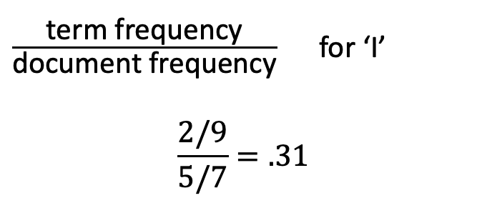
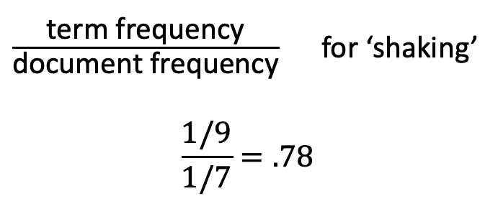
term frequency-inverse document frequency (tf-idf)
What helps with morning sickness?
How many months should I breastfeed?
I passed out and Mom said I was shaking
Where is the nearest clinic?
I am having heavy bleeding, what should I do?
What foods should I eat while pregnant?
My heart is racing and I can’t catch my breath
$\frac{\text{term} \text{frequency}}{\text{document} \text{frequency}}$ for ‘shaking’
$$\frac{1/9}{1/7}=.78$$
$\frac{\text{term} \text{frequency}}{\text{document} \text{frequency}}$ for ‘I’
$$\frac{2/9}{5/7}=.31$$

Slide 43
Preprocessing
I passed out, and Mom said I was shaking.
remove punctuation
to lowercase
“tokenization”
“stemming”
I passed out and Mom said I was shaking
i passed out and mom said i was shaking
[i, passed, out, and, mom, said, i, was, shaking]
[i, pass, out, and, mom, said, i, wa, shake]

